Slide 1
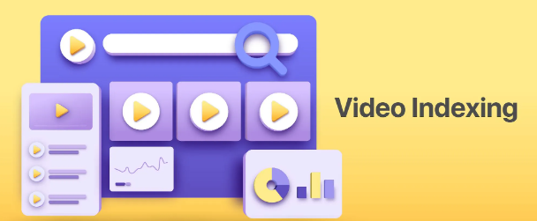

Video Indexing Application Using Amazon Rekognition
Tanya Chhabhadiya
20210701007
Course Code and Title: 21BSCS35C03 – AWS Cloud

Slide 2
Contents
Introduction
Workflow
Set the security permissions
Configure AWS SNS and AWS S3
Understanding the AWS SDK Documentation
Configuring a Web application for Video Indexing
Detect Labels in a Video
Detect Faces in a Video
Detect Celebrities in a Video

Slide 3
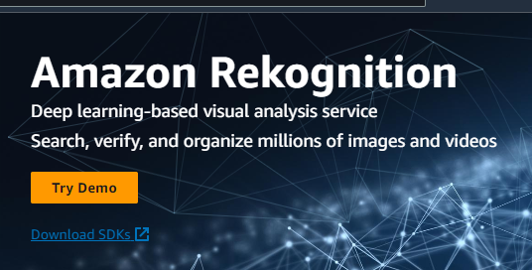
Introduction – Amazon Rekognition
Detection and recognition
Text extraction
Real time analysis
Custom labels
Integration with AWS Services
Security and compliance
API and SDKs
Amazon Rekognition is a cloud-based computer vision service offered by Amazon Web Services (AWS) that provides various image and video analysis capabilities.

Slide 4
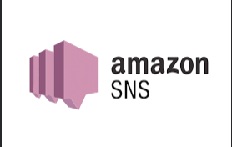
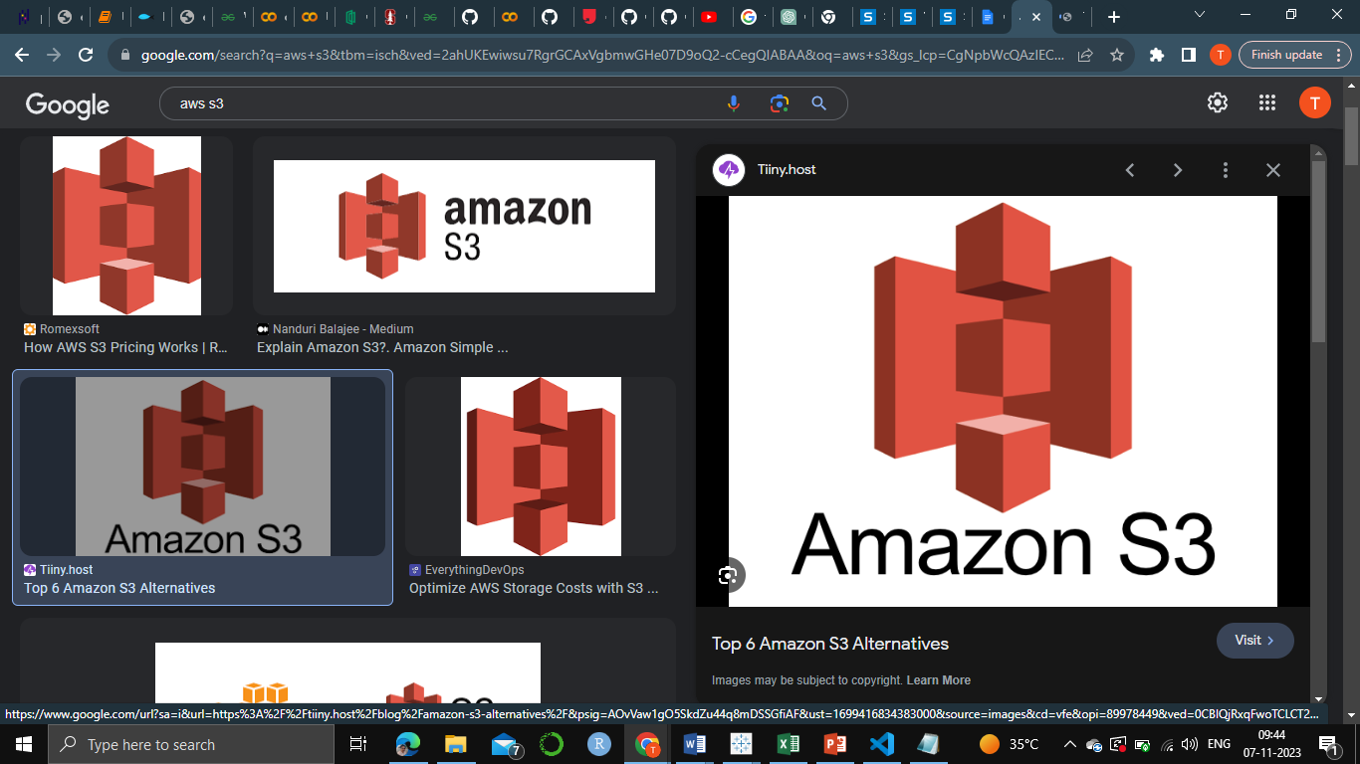
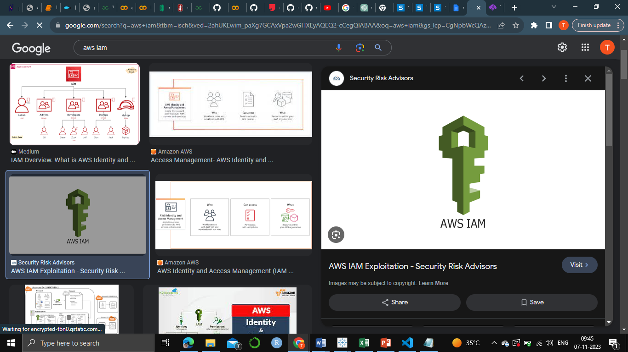
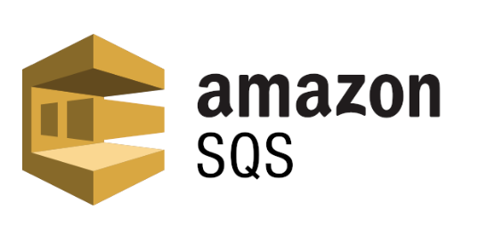
Other services
SNS: Amazon SNS is a fully managed messaging service provided by AWS. It enables you to build distributed, highly available, and fault-tolerant applications. SNS allows you to send messages or notifications to a large number of recipients, including individuals or application endpoints.
S3: Amazon S3 is a highly scalable and durable object storage service that allows you to store and retrieve data. It is widely used for a variety of applications, including data storage, backup, and web hosting.
IAM: AWS IAM is a service that allows you to control access to AWS resources. It enables you to create and manage users, groups, and roles, and set permissions to control who can access your AWS resources and what actions they can perform.
SQS: Amazon SQS is a fully managed message queuing service that enables decoupling of the components of a cloud application. It provides a reliable and scalable way to transmit any volume of data between distributed software components.

Slide 5
Project Description
Project Name: Video Indexing
Web Technologies: HTML, CSS, JavaScript
Cloud Platform: Amazon Web Services (AWS)
Storage: Amazon S3 for secure and scalable video storage
Security: IAM roles and permissions for access control
Notification System: AWS SNS for real-time result notifications
Asynchronous Processing: AWS SQS for background task management
Analysis Services: Amazon Rekognition for label detection, text recognition, facial analysis, and celebrity identification
User Interface: Intuitive web application allowing seamless video uploads
Versatility: Applications include content moderation, sentiment analysis, and celebrity recognition

Slide 6
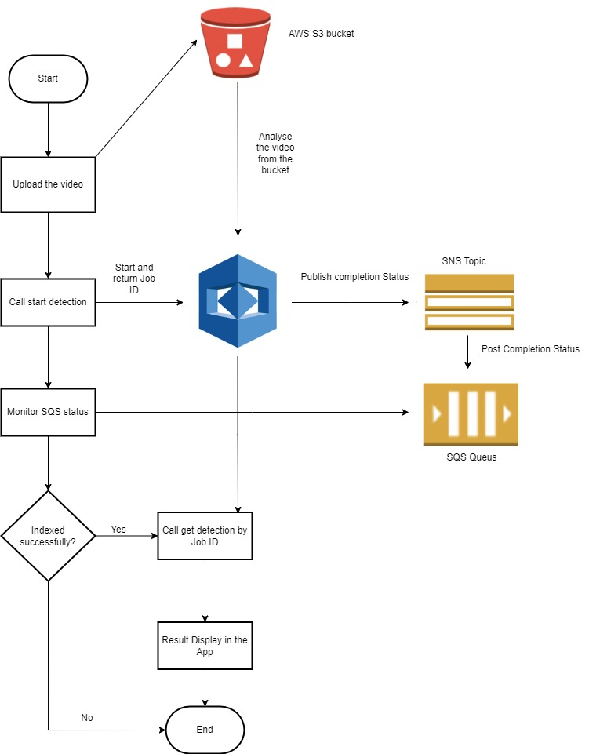
Workflow

Slide 7
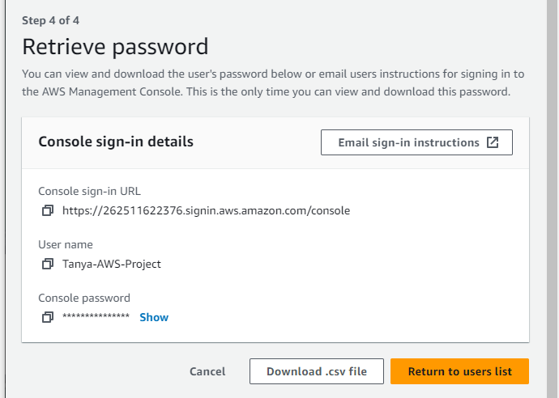
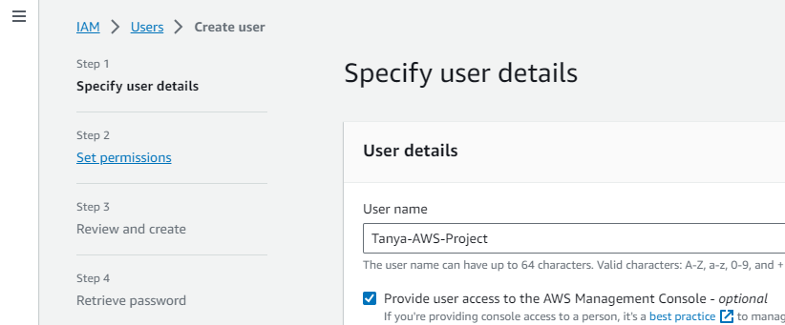
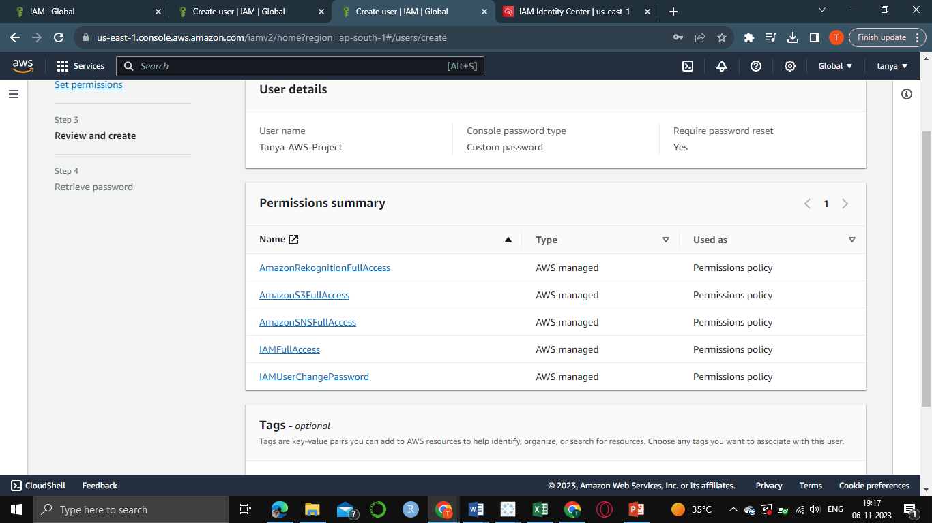
Set Role and Permissions (IAM)
For the security permissions, IAM (AWS Identity and Access Management) is used.
In IAM a user and role for the user is created through which they can access the service through the web application
publically. The steps are:
Create user
Set permissions and allow policies
Download credentials

Slide 8
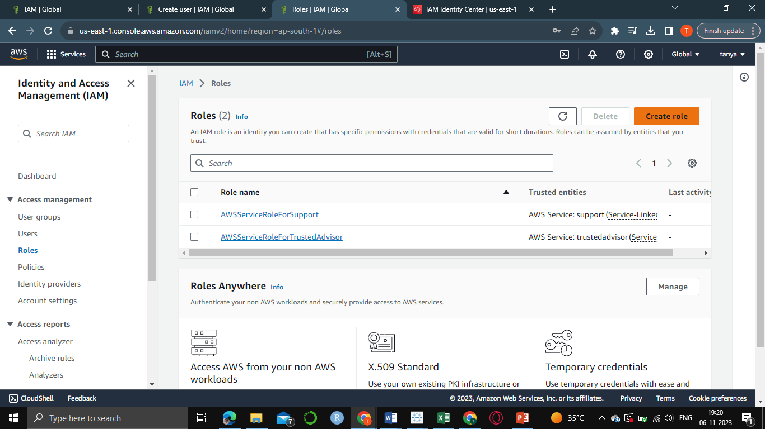
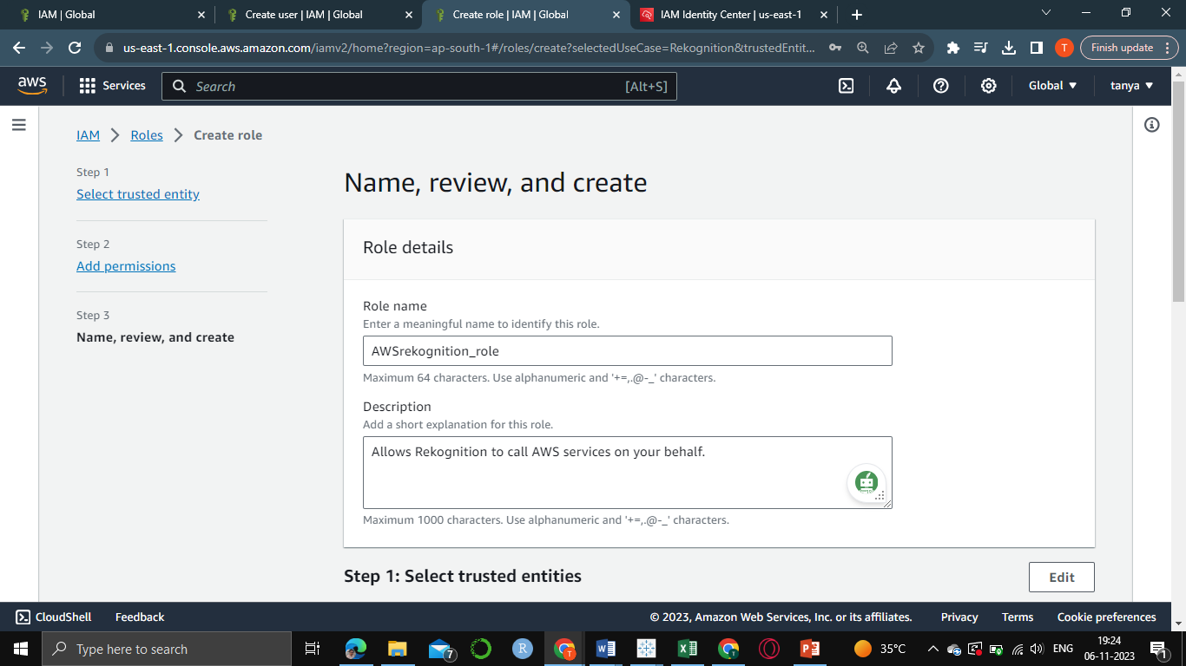
Create role
Enter necessary details
Review and set permissions

Slide 9
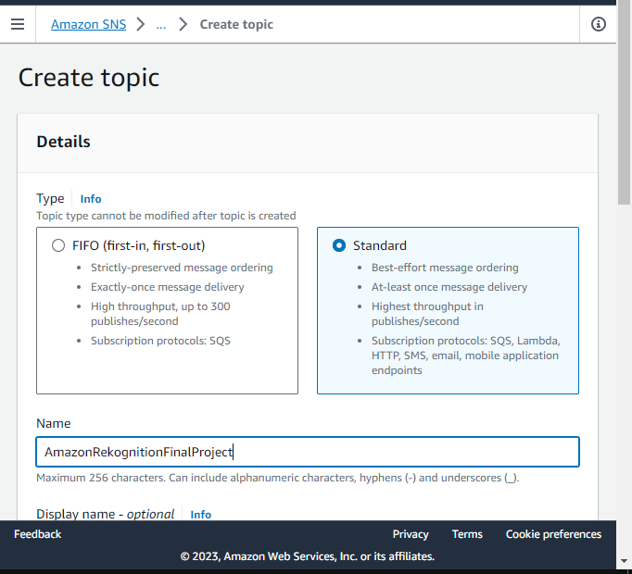
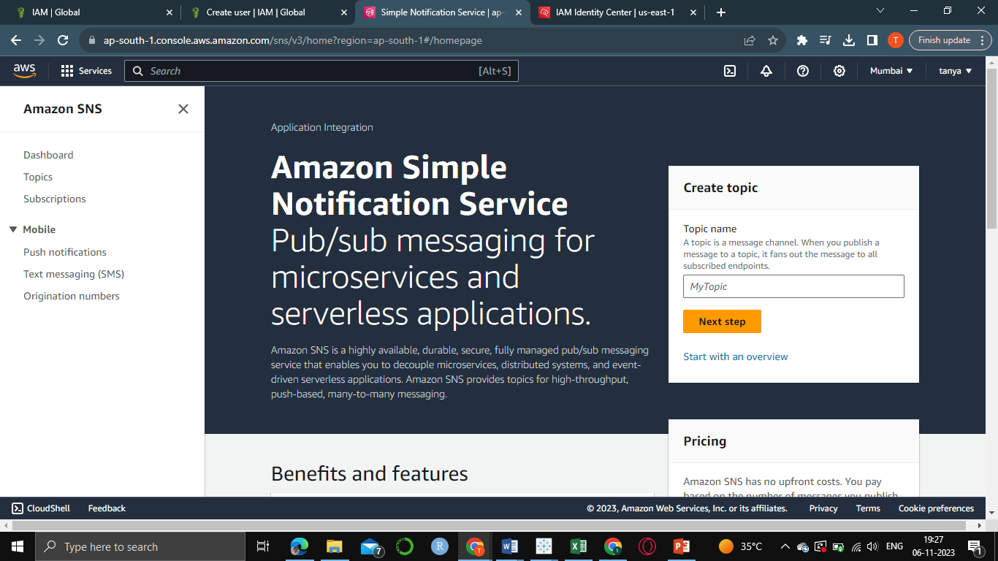
Configure SNS
Create topic
Use standard option
Select the name of service for which the SNS is used.

Slide 10
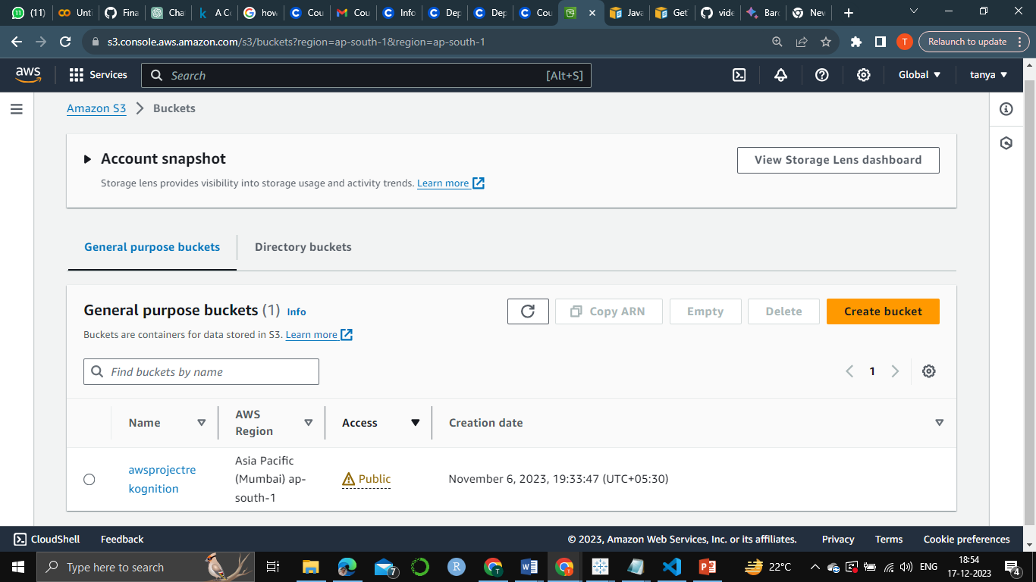
Configure S3
Create the bucket
Enter details like region name, public access allowance correctly.
Go to permissions after bucket is created and set the CORS and bucket policy

Slide 11
Understand AWS SDK Documentation
In order to use command like get and start we use SDK Documentation for Rekognition API. The code for JavaScript is used for building the web application
The steps are:
Familiarize yourself with the AWS SDK documentation for the programming language of choice (e.g., JavaScript).
Learn how to authenticate and interact with AWS services programmatically using the SDK.
Understand key concepts like AWS credentials, service endpoints, and error handling.
https://docs.aws.amazon.com/AWSJavaScriptSDK/latest/AWS/Rekognition.html

Slide 12
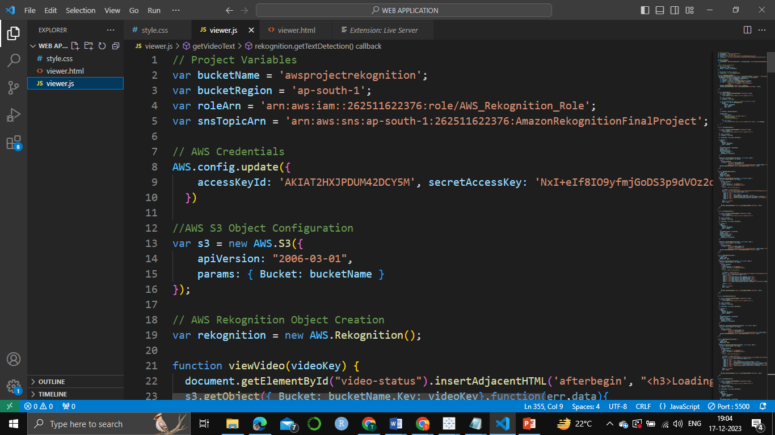
Configure web application
Create the HTML page containing buttons for the functions like upload video, detect labels etc.
Create a stylesheet for design
Using the reference from the SDK Documentation For Rekognition API build the JavaScript file.
Add credential that were generated while setting IAM permission.
Add bucket name, region name, SNS ARN and Role ARN in the JavaScript file.

Slide 13
Enable detect labels, text, faces in JavaScript

Slide 14
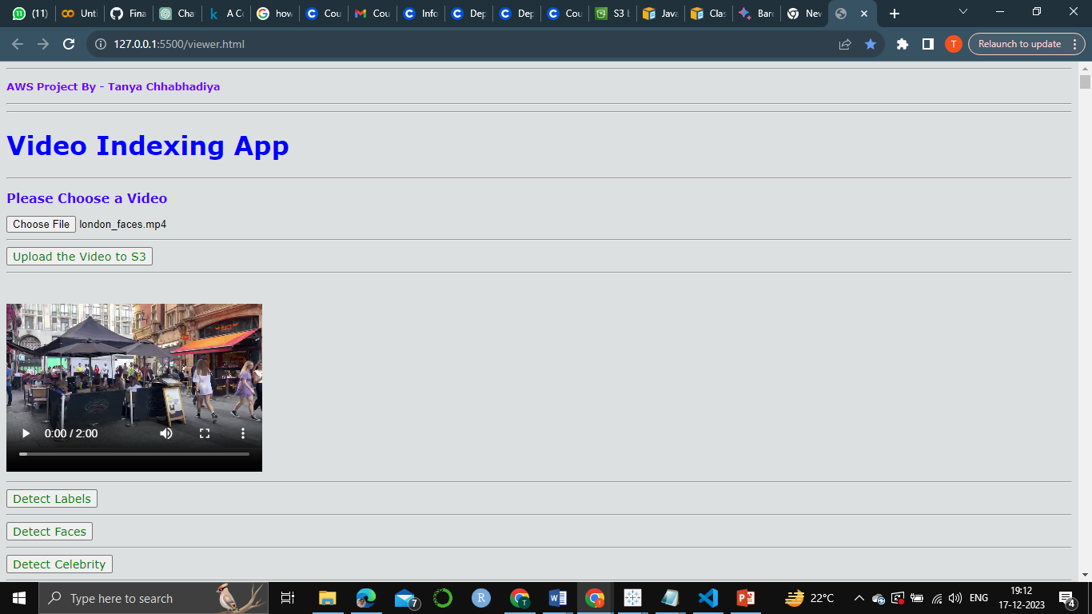
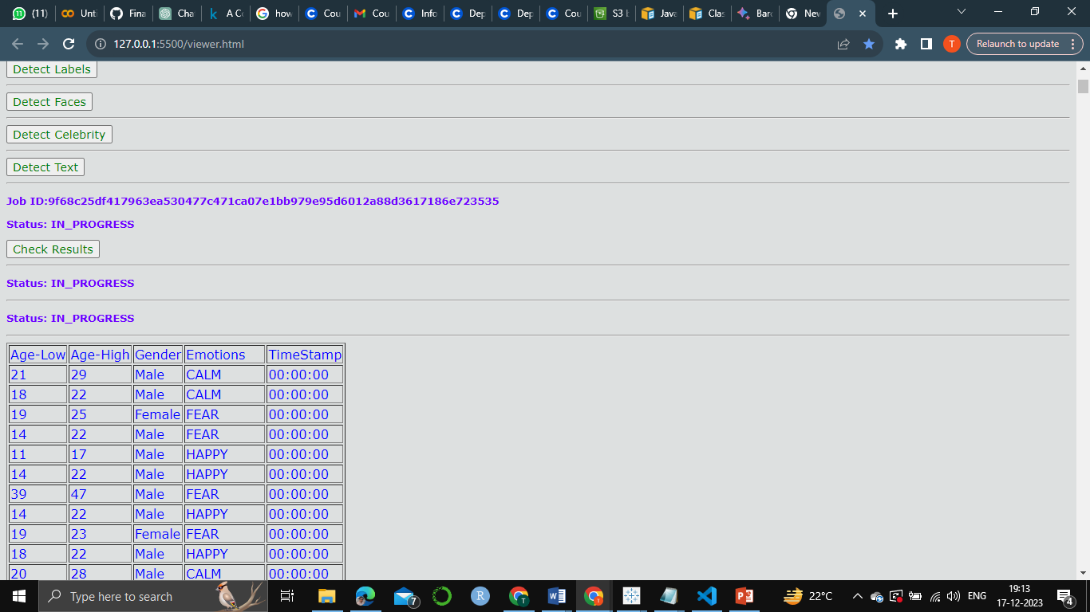
Result
http://127.0.0.1:5500/viewer.html

Slide 15
Conclusion
The Video Indexing project delivers a powerful and user-friendly solution for comprehensive video content analysis.
Users can seamlessly upload videos through an intuitive web interface, and the application securely stores them in an Amazon S3 bucket, enforcing robust IAM roles and permissions.
Leveraging the capabilities of Amazon Rekognition and integrated AWS services like SNS and SQS, the project enables the detection of labels, faces with emotions, text, and even celebrities within the videos.
Real-time notifications keep users informed of analysis results.
The web application, crafted with HTML, CSS, and JavaScript, offers an accessible platform for content moderation, sentiment analysis, and celebrity recognition.

Slide 16


